Slide 1
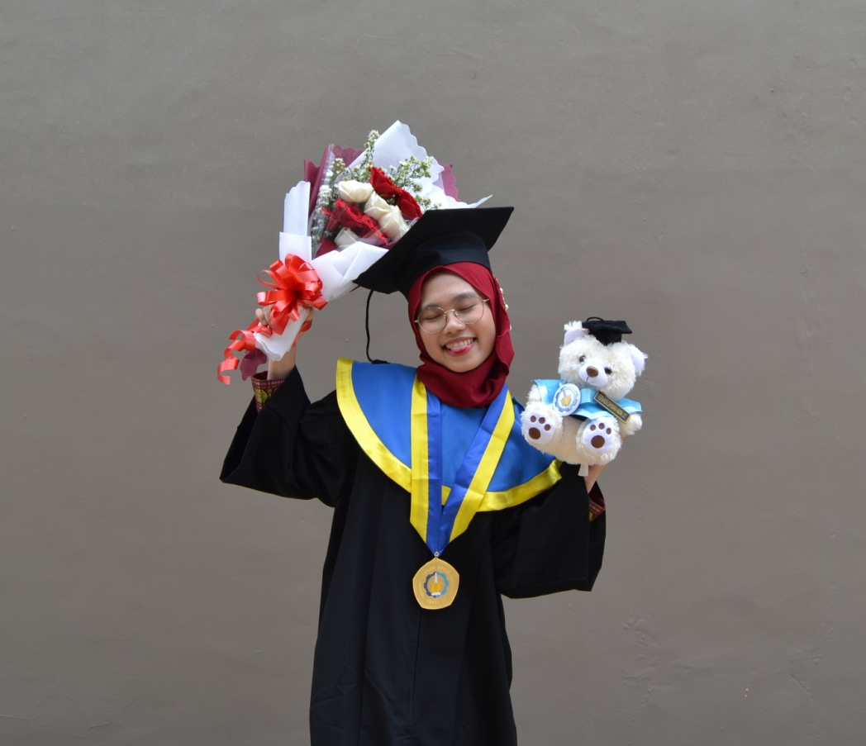
DOB :
Magelang. 21 Aug 1998
Contact Number :
+62 81212 719895
Address :
Komp. AURI Kebantenan Indah Jl. Bronco 3/9, Jatiasih Bekasi, Indonesia
Portofolio :
Fernanda Daymara Hasna
linkedin.com/in/fernandahasna
github.com/fdhasna21

Slide 2
EDUCATION
12 BEKASI MIDDLE HIGH SCHOOL
Member of Junior Red Cross SMPN 12 Bekasi
2010 - 2013
Bekasi, West Java
5 BEKASI SENIOR HIGH SCHOOL
Major in Natural Science
Member and Comitee of ICT SMAN 5 Bekasi
2013 – 2016
Bekasi, West Java
INSTITUT TEKNOLOGI SEPULUH NOPEMBER
Bachelor of Engineering
Major in Computer Engineering
Member and Comitee of ITS Robotics
2016 – 2020
Surabaya, East Java

Slide 3
EXPERIENCE
PT. KERETA API INDONESIA (PERSERO)
Internship at IT Operation
Main Headquarter of PT. KAI
Jul 2019 – Aug 2019
Bandung, West Java
IT PROJECT MANAGEMENT TRAINING
Participant of Thematic Academy
Digital Talent Scholarship (DTS) 2020
Nov 2020
Online Course
STUDENT MANAGEMENT SKILL TRAINING
Participant of PreBasic until Intermediate Level
Institut Teknologi Sepuluh Nopember
2016 - 2019
Surabaya, East Java
2D GAME DEVELOPING WORKSHOP
Participant of “Construct 2 : Easy Way to CreateGame”
BEKRAF Game Prime Workshop 2016
Nov 2016
Surabaya, East Java

